Slide 1

Rental Car Cancellation Predictor
Michael Engeling

Slide 2
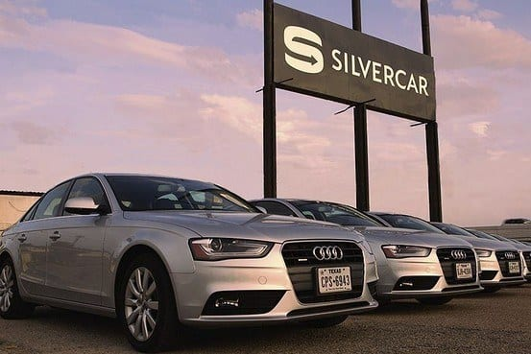
Project Motivation
Silvercar doesn’t charge customers for cancellations
Users can create reservations without creating an account or entering credit card info
Consequently, 41% of Silvercar’s reservations result in cancellations

Slide 3
Objective
Predict when users will cancel reservations to help Silvercar:
Better manage their fleet of cars
Improve short-term revenue forecasts
Potentially identify opportunities to prevent cancellations
Results:
80% accuracy using a gradient boosting classifier

Slide 4







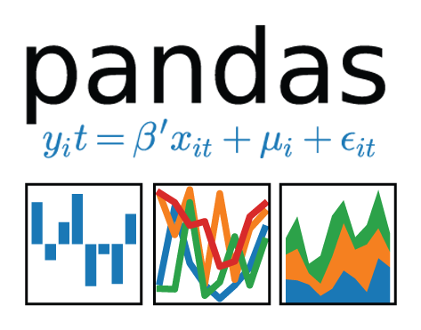



Technologies

Slide 5
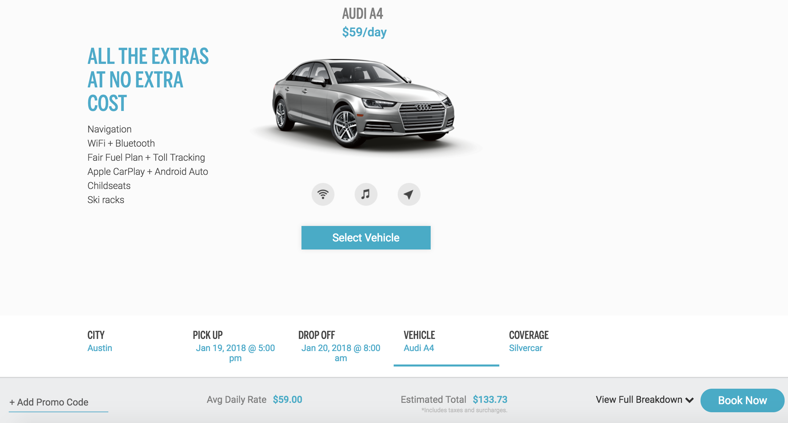
Data:
Reservations
Users
Promotions
Locations

Slide 6
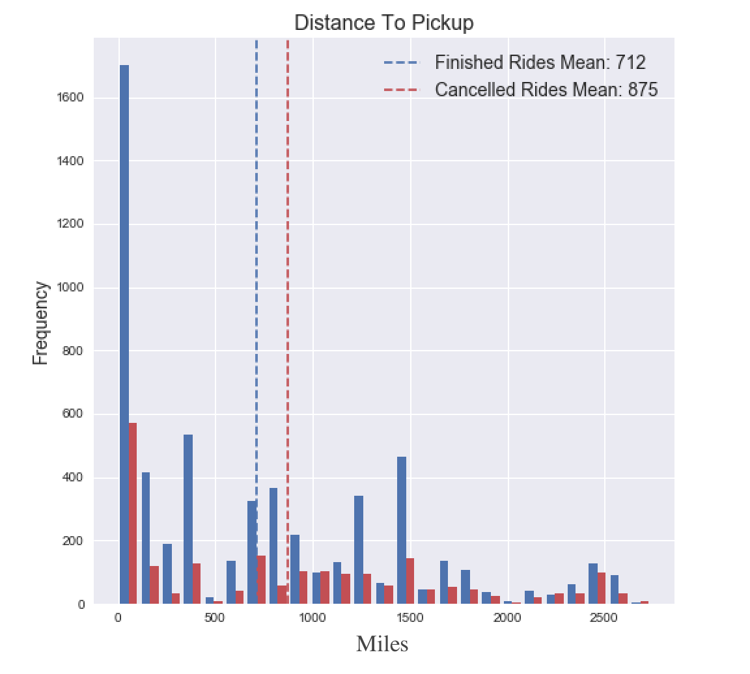
Challenges
Initial model was 95% accurate
Stripped out features that couldn’t be used in real model
Focused on features that would be available, such as distance travelled

Slide 7
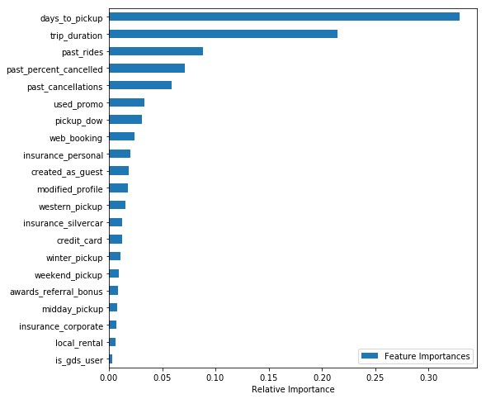
Feature Importances
Numerical:
Days to pickup
Trip duration
Past Rides
Percent of past rides cancelled
Categorical:
Used promo
Pickup day of week
Web booking
Insurance personal
Guest
Notes:
- Gradient boosting classifiers have misleading feature importances when categorical and numerical features are mixed. In this case, the numerical features are weighted more heavily even though all of the features were standardized. Feature importances have to be evaluated separately for the numerical and categorical features.
- The features that are highly correlated can also be used interchangeable, so need to be cautious when ascribing importance to features whose relative importance could be switched

Slide 8
Future Improvements
Work with Silvercar to incorporate user data into the model
See if it’s possible to use historical user data
Look into different existing data sources
Investigate new ways to acquire user data

Slide 9
Web Application
Live Demo

Slide 10



Questions? Contact Me
michael.engeling@gmail.com
linkedin.com/in/mengeling/
github.com/mengeling/Silvercar-Cancellation-Predictor

